Slide 1
BERYL HUB
BY
B.L.MOUNIGHA
V.S.SWETHA
I st year, PSNACET.

Slide 2
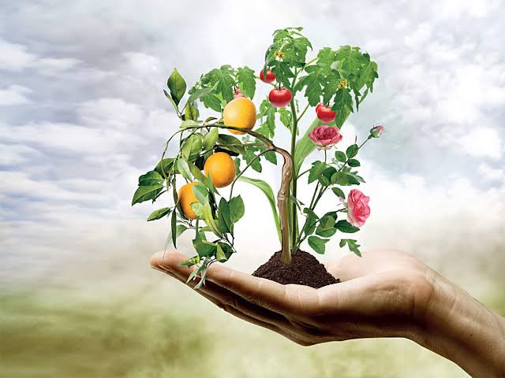
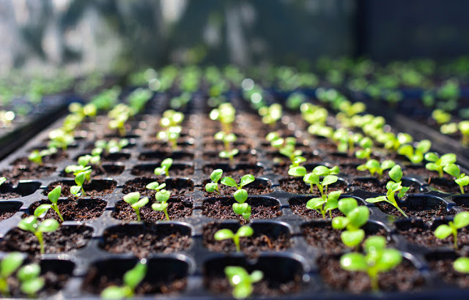
INTRODUCTION
Agriculture plays a critical role in the entire life of a given economy. Agriculture is the backbone of the economic system of a given country. In addition to providing food and raw material, agriculture also provides employment opportunities to a very large percentage of the population.
Horticulture is the art of cultivating plants in gardens to produce food and medicinal ingredients, or for comfort and ornamental purposes. Horticulturists are agriculturists who grow flowers, fruits and nuts, vegetables and herbs, as well as ornamental trees and lawns.
Types of Horticulture are Olericulture, fruticulture, Viticulture, Floriculture, Turf management, Arboriculture, Landscape horticulture, Postharvest physiology.

Slide 3
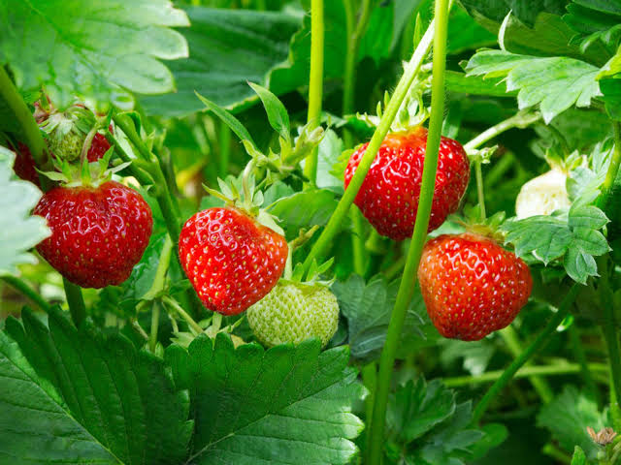
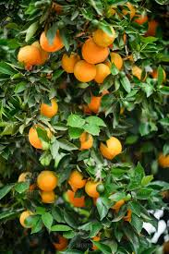
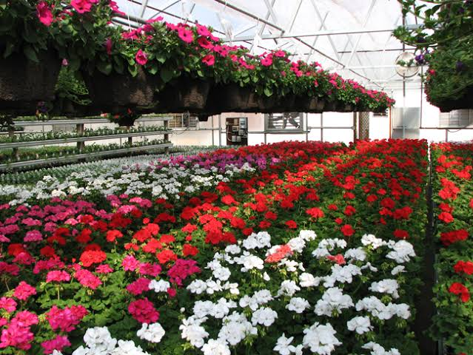
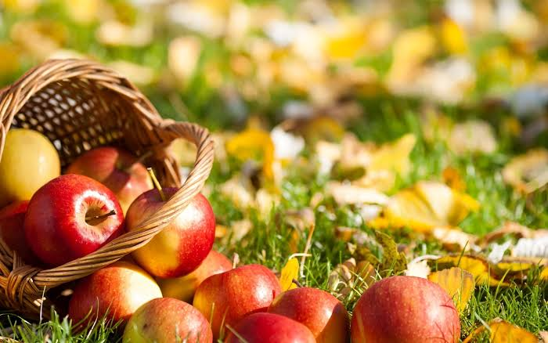
EXISTING SYSTEM
There are several agriculture app but they are not effectively used.
They are used to identify disease, market prices etc... but they do not have all necessary facilities.
They are yet to be developed.
They are not efficiently used in the field of agriculture and horticulture.

Slide 4
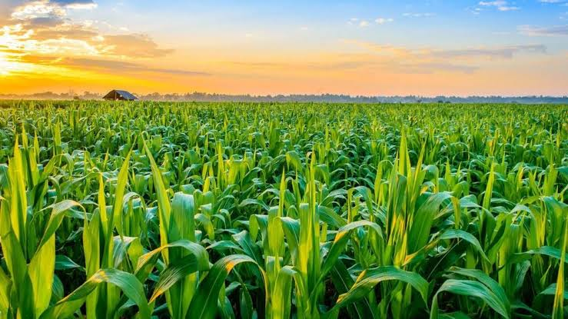
PROPOSED SYSTEM
This app not only focus on agriculture but also on Horticulture.
Helps us to find professional for setting up of organic farming in house.
It also sell framing related material like seed, gardening tools, pots, seeds, Fertilizer, soil, pesticides and herbal related products.
Scanning system is used to identify the disease of the crops and plants and it gives remedies.
Plant experts can also be contacted.
Daily market price of the crops, vegetables, Fruits, flowers, etc… is also provided with market analysis.
Fertilizer and pesticides calculator, weather reports is also installed.
This apps connects the farmers and the shopkeeper directly, avoiding any intermediaries.
It also gives us the location for buying livestock. It also helps us in getting necessary materials to rear livestock.

Slide 5
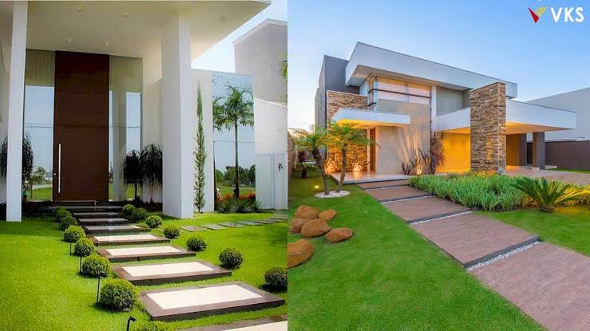
It has a 3D lawn designer which helps us in designing it.
This app divided the plant like Outdoor plants, Indoor plants, Flowering plants, Water plants ,Decorating plants, Creepers, Climbers etc..
This also included flower shop and you can also create your own bouquet, rith ,wreath ,flower ornaments and garlands.
This app describes each and every plants with their uses.
It also provides tip to grow plant and how to cure them if they are disease infected.
It also analyses the quality of the plants and the suitable conditions to grow it.
This app can also be used as a platform to buying and selling flowers and plants.
It also helps us to contact experts in lawn designer.
It also sells products related to decoration of garden and lawn designing.
It gives us the location of nursery near and the variety of plants in them.

Slide 6
BENEFITS
It benefits farmers by avoiding intermediaries.
Disease analysis, market analysis, Fertilizer and pesticides calculator plays a major role.
Helps in finding the necessary materials easily without wasting much effort or time.
Curing ,crops and plants are made easy.
Agriculture and Horticulture can be done effectively.
Plant guide are also installed for people.
It helps Agriculturists, Horticulturists, and even people in assisting their farming.
CONCLUSION
It acts as connection between the farmer and the shopkeeper. Farming can be done easily with the help of it.

